Slide 1
Sales and Financial Dashboard
Prepared by Ezhilarasi, Data Analyst Intern

Slide 2
Objective
The objective of this dashboard is to provide business stakeholders with an interactive and insightful view of sales and profitability performance. It helps track key metrics such as total sales, profit, and profit margins, analyze trends over time, and compare performance across regions and product categories. This enables data-driven decisions to identify growth opportunities and improve business outcomes.

Slide 3
Dataset Overview
Source: Sales & Financial Dataset (Kaggle)
Size: ~7,000 – 10,000 records (approx.)
Time Period: Covers multiple years of sales transactions
Key Columns Used:
Order Date → for time-series analysis
Sales → revenue generated
Profit → profitability of sales
Quantity → units sold
Discount → applied discount percentage
Region → geographical segmentation
Category & Sub-Category → product classification
Customer & Segment → customer details for analysis

Slide 4
Key KPIs
Total Sales – Overall revenue generated.
Total Profit – Profit earned after costs.
Profit Margin % – Profitability ratio.
Sales Growth / Trend – Performance over time.
Regional & Category Insights – Sales and profit by geography & product type.
Top/Bottom Performance – Best and least performing products/regions.

Slide 5
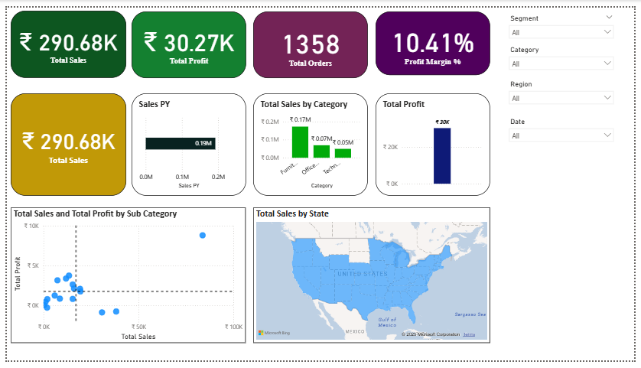
Dashboard Design

Slide 6
Insights
The North Region records the highest sales, but profit margins are relatively
lower compared to other regions.
The Technology Category shows the fastest growth in both sales and profit.
Q4 consistently records peak sales, suggesting strong seasonal demand.
Some Sub-Categories generate high sales but low profit, highlighting
areas for cost optimization.

Slide 7
Interactivity Features
Slicers – Filters added for Region, Category, and Time Period to analyze specific segments.
Drill-down – Ability to explore trends at different levels (e.g., yearly → quarterly → monthly).
Dynamic Charts – Visuals update instantly based on selected filters.
Cross-filtering – Selecting one chart updates other visuals for deeper insights.

Slide 8
Interview Prep
What is a KPI? A KPI (Key Performance Indicator) is a measurable value that shows how well a business is achieving its goals (e.g., Sales, Profit, Profit Margin).
What are slicers in Power BI? Slicers are interactive filters that let users view data by specific fields such as Region, Category, or Time Period.
Difference between Power BI and Tableau?
Power BI → Easier integration with Microsoft tools, more user-friendly for beginners.
Tableau → Stronger in advanced visualizations, widely used for complex analytics.

Slide 9
Conclusion
The dashboard provides a clear and interactive view of sales, profit, and growth trends across regions and categories. It enables stakeholders to monitor key KPIs, identify high-performing and underperforming areas, and analyze seasonal trends, supporting faster and more informed business decisions.

Slide 10
Thank You 🙏
Thank you for reviewing my dashboard presentation. I look forward to your feedback and suggestions.

